Slide 1
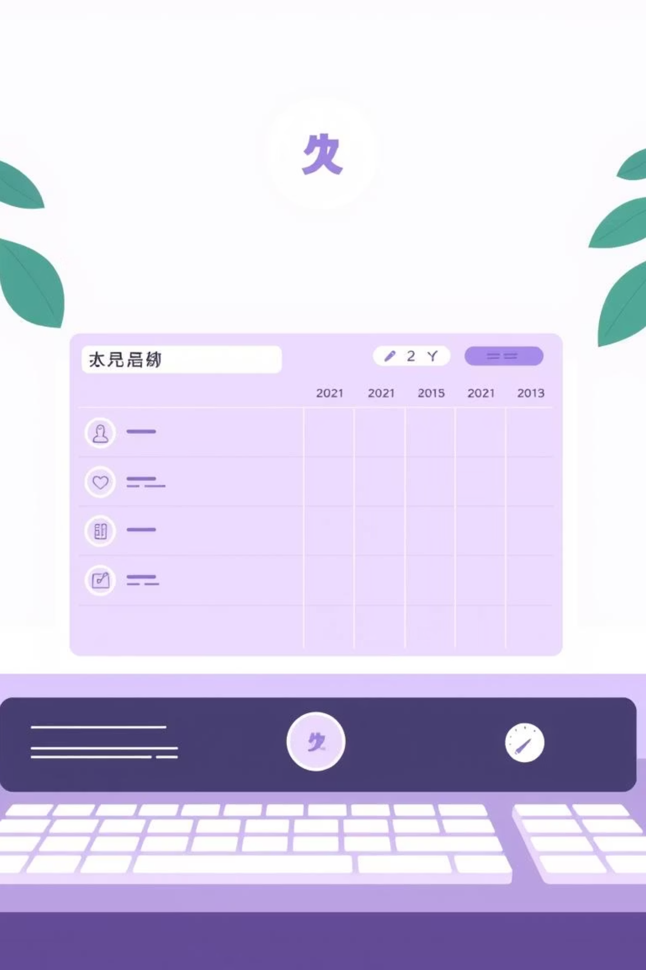
Electronic Health Records (EHR) & Appointment Management System
A pioneering project from the Department of CSE, Daffodil International University
Course: CSE323 – Operating Systems Lab
Submitted By:
Shuvo Singh Partho
Md. Nayeem Hasan
Md. Sorowar Jahan Ishan
Md. Tanvir Hasan
Shoukhinuzzaman Aditto
Submitted To:
Md. Aman Ullah, Lecturer, CSE

Slide 2


Revolutionizing Healthcare: The Need for Digital Transformation
Traditional healthcare systems often struggle with inefficiencies, leading to patient dissatisfaction and operational bottlenecks. Manual record-keeping is prone to errors, delays, and security risks.
Our project addresses these critical issues by introducing a robust Electronic Health Records (EHR) and Appointment Management System, designed to streamline processes and enhance patient care.
Challenges in Traditional Healthcare
Purpose of the Project
Manual records & paperwork
Enhance efficiency & accuracy
Extended wait times
Improve patient experience
Risk of human error
Secure health data management
Fragmented patient information
Modernize healthcare workflows

Slide 3

Key Objectives: Building a Seamless Healthcare Experience
1
2
Secure EHR Database
Online Appointment Booking
Develop a robust, scalable, and secure Electronic Health Record database to store patient data.
Implement real-time appointment scheduling with instant availability updates for patients and clinics.
3
4
Intuitive Dashboards
Automated Notifications
Create specialized dashboards for doctors and administrators to manage schedules and patient records efficiently.
Integrate SMS and email alerts for appointment confirmations, reminders, and important updates.
5
6
Robust Security & Validation
Streamlined Workflows
Ensure strong user authentication, data validation, and encryption to protect sensitive health information.
Automate key healthcare processes to reduce manual intervention and improve operational efficiency.

Slide 4
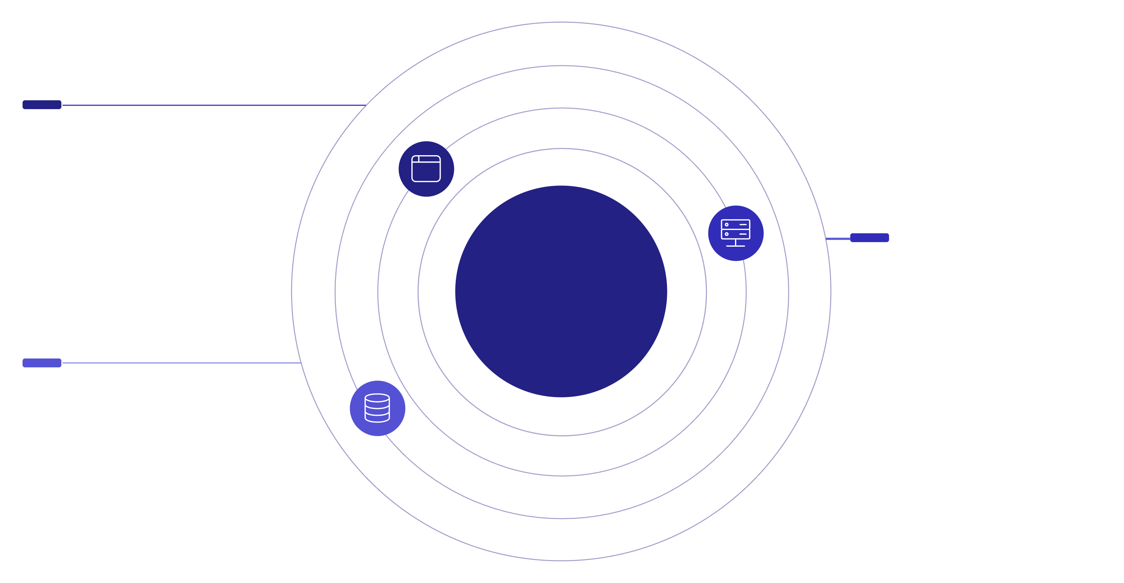
System Architecture: A Robust 3-Tier Foundation
Our system is built on a reliable 3-tier architecture, ensuring scalability, security, and efficient data handling.
Frontend
HTML, CSS, JavaScript presentation layer
Role-Based Access Control
Backend
PHP application logic and APIs
Database
MySQL persistent storage
Frontend (Presentation Layer)
Backend (Application Layer)
Developed using HTML, CSS, and JavaScript for a responsive and intuitive user interface.
Powered by PHP to handle business logic, data processing, and communication with the database.
Database (Data Layer)
Role-Based Access Control
Utilizes MySQL for secure and organized storage of all electronic health records and appointment data.
Ensures that users can only access functionalities and data relevant to their specific roles (e.g., patient, doctor, admin).

Slide 5
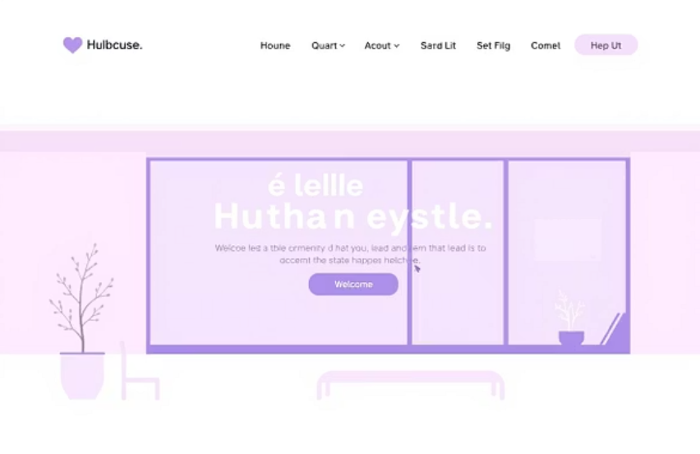
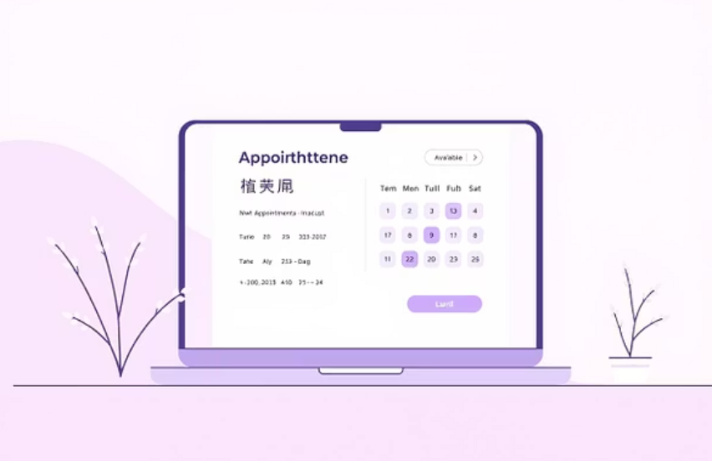
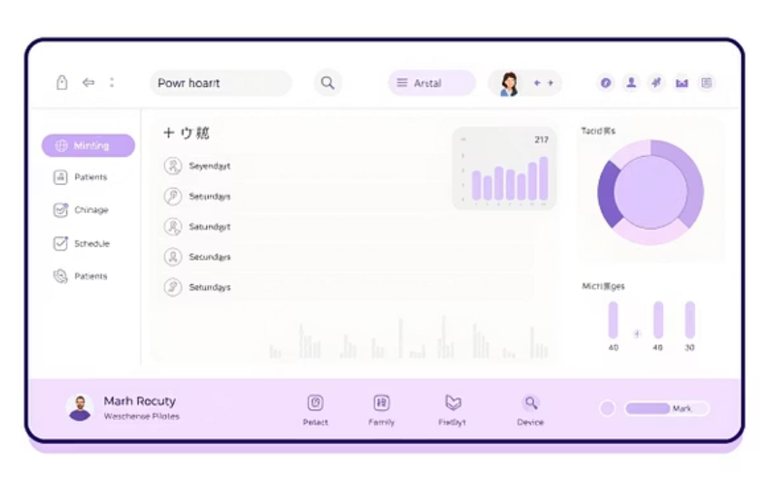
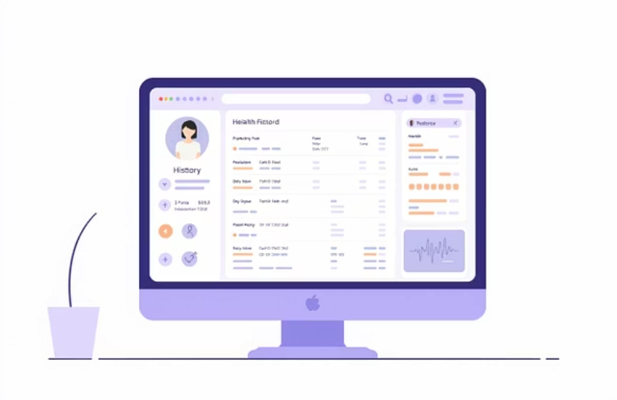
System Interface: A Glimpse into User Experience
Our user-friendly interface is designed for clarity and ease of navigation across different user roles.
Home Page
Appointment Booking
Welcoming and easy-to-navigate for all users.
Seamless scheduling with real-time updates.
Doctor Dashboard
Patient EHR View
Comprehensive tools for managing patient care.
Secure access to personal medical history.

Slide 6
Workflow: From Patient to Physician
Our system optimizes the patient journey from scheduling an appointment to receiving notifications, ensuring a smooth and efficient process.
Patient Registration
New patients create secure accounts.
Appointment Scheduling
Patients browse available slots and book appointments online.
Backend Validation
System verifies appointment availability and patient details.
Doctor Confirmation
Doctors review and either confirm or reschedule appointments.
EHR Update
Upon consultation, patient's electronic health record is updated.
Automated Notifications
Patients receive SMS/email confirmations and reminders.

Slide 7
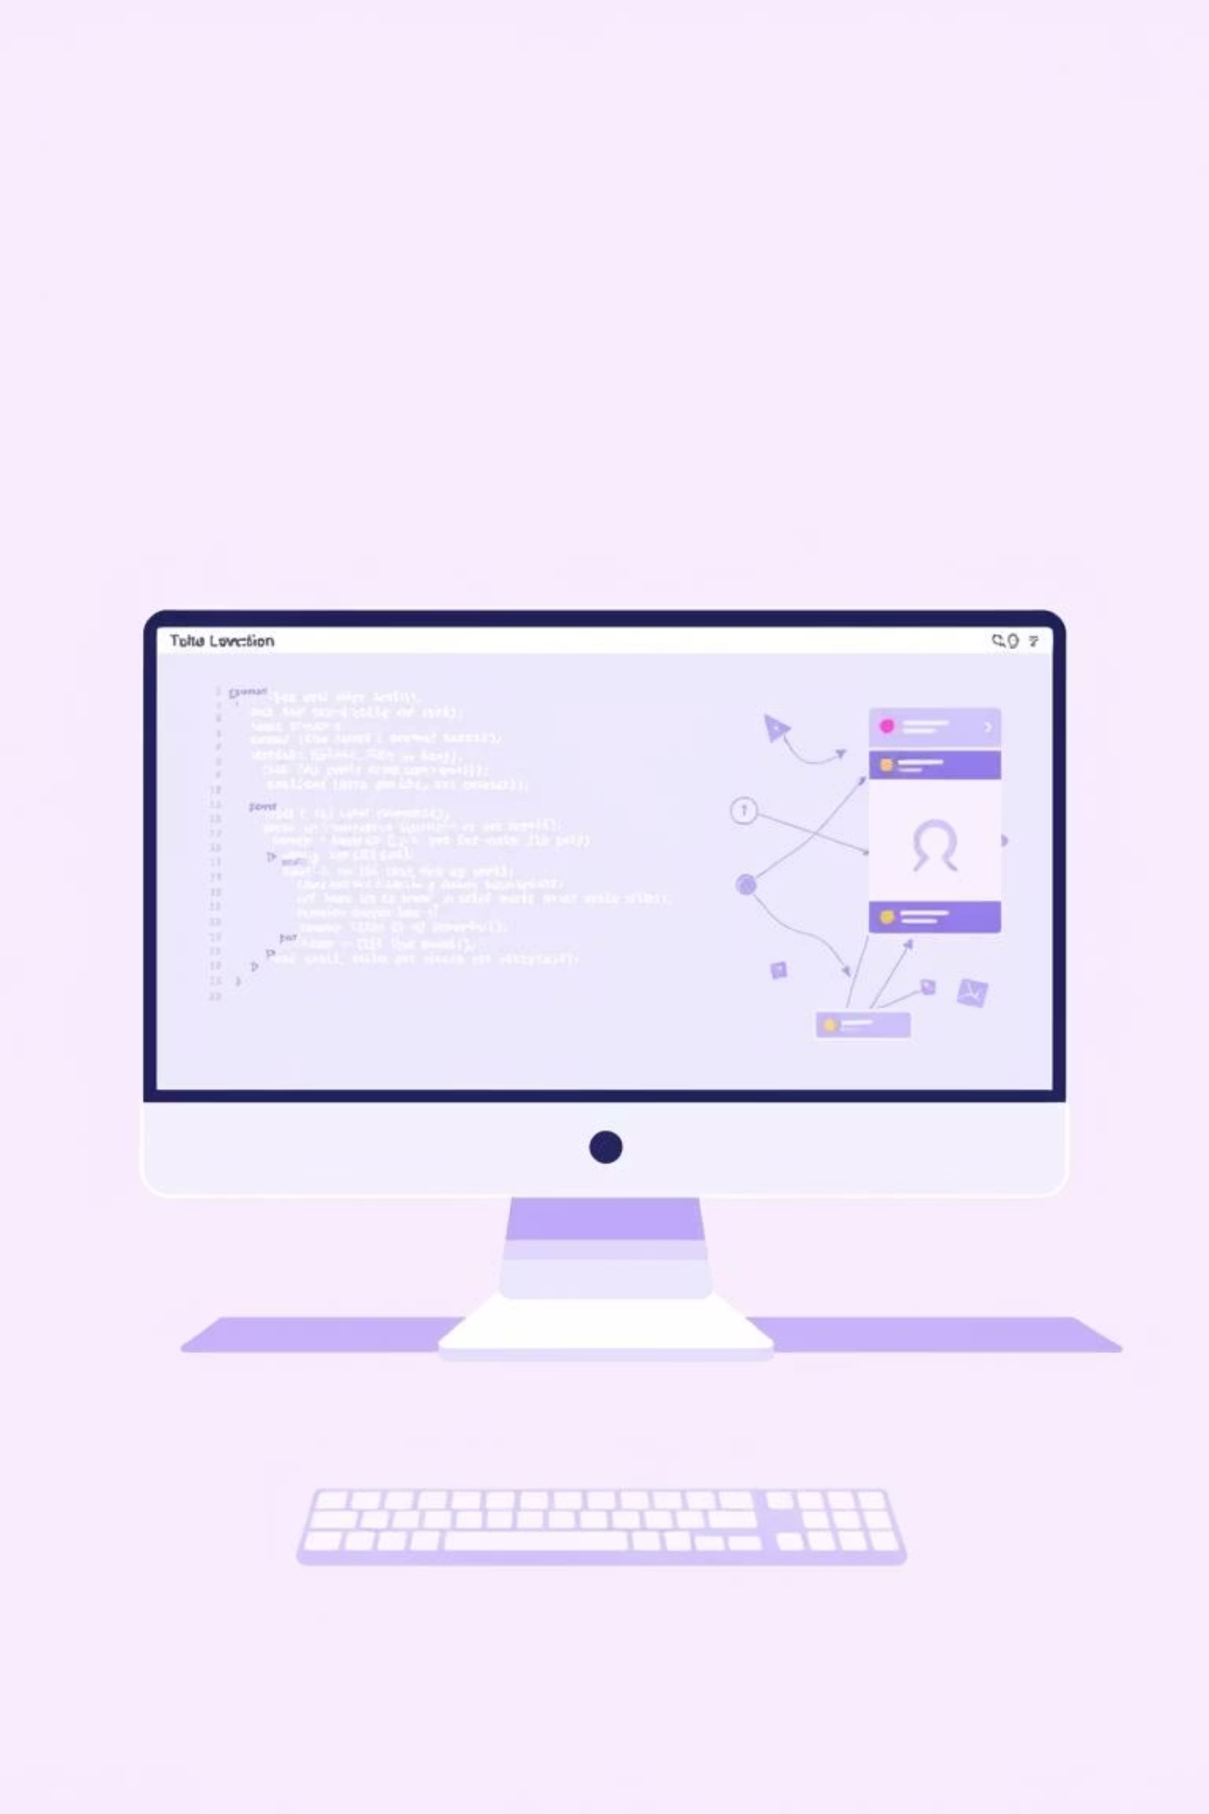
Implementation Details: Engineering for Robustness
Our implementation focuses on structured design, efficient data handling, and paramount security measures.
Database Architecture
Appointment Validation
Comprehensive schemas for patients, doctors, appointments, and insurance.
AJAX-driven real-time validation for instant slot checking.
Minimizes booking conflicts and enhances user experience.
Optimized relationships for quick data retrieval and integrity.
Security Protocols
API Integration
Bcrypt hashing for password protection.
RESTful API for seamless communication between frontend and backend.
Input sanitization to prevent SQL injection and XSS attacks.
Ensures modularity and future extensibility.
Secure session management for user authentication.

Slide 8



Performance & Impact: Tangible Results
Our system delivers significant performance improvements and positive outcomes for healthcare providers and patients alike.
1.2s
100+
Page Load
Concurrent Users
30%
Rapid loading times for a smooth user experience.
System efficiently handles high user traffic.
< 0.05s
99%
Query Time
Booking Success
Reduced No-Shows
Lightning-fast data retrieval from the database.
Near-perfect rate for successful appointment bookings.
Automated reminders significantly decreased missed appointments.
40%
Faster Diagnosis
Quick access to EHR streamlines the diagnostic process.
Highly Positive
User Satisfaction
Feedback indicates a much-improved user experience.

Slide 9

Future Work: Innovating for Tomorrow's Healthcare
Our vision extends beyond current functionalities, integrating cutting-edge technologies to further enhance the healthcare ecosystem.
AI-Based Prediction
Implement AI for predicting no-shows and optimizing appointment schedules.
Telemedicine Integration
Develop WebRTC-based video call functionality for remote consultations.
IoT Device Integration
Connect with wearable health devices for continuous patient monitoring and data collection.
Blockchain Audit Trail
Utilize blockchain technology for an immutable and secure audit trail of medical records.

Slide 10

Conclusion: A Foundation for Digital Healthcare
The Electronic Health Records and Appointment Management System stands as a testament to improved healthcare workflows and a future-ready digital infrastructure.
Enhanced Workflow
Reduced Inefficiencies
Significantly improved efficiency in managing patient data and appointments.
Eliminated errors, minimized wait times, and drastically cut down manual administrative tasks.
Scalable Foundation
Provides a robust and adaptable base for integrating future healthcare technologies.
Thank You
For your attention and support in building the future of healthcare.

